Slide 1

Department of Computer Science and Engineering
Optimizing Class Imbalance and Enhancing Intrusion Detection in SDN Environments using
Deep Learning Models
PRESENTED BY
Gorige Venkatesh (21471A05M5)
Dasappagari Sreenivas (22475A0521)
Meda Venkatesh (21471A05N6)
Under the Guidance of,
kKunda Suresh Babu _{Ph.D.},
Associate Professor,
Department of Computer Science and Engineering,
Narasaraopeta Engineering College (Autonomous),
Narasaraopet- 522 601.

Slide 2
OUTLINE
Abstract
Introduction
Literature Survey
Research Gaps
Problem Statement
Objectives
Block Diagram / Flow Diagram
Methodology
Implementation
Results and Analysis
Conclusion & Future Scope
References
Question and Answers
Acknowledgements

Slide 3
ABSTRACT
This research aim is to addresses the critical issue of class imbalance in intrusion detection systems (IDS) in Software-Defined Net working environments. This paper introduces a novel approach that exploits advanced deep learning techniques to improve minority class attack detection, often missed because they are rare. Balancing the dataset using data synthesis with GAN and SMOTE, this study allows different classifiers to improve their performance. The research explores the effectiveness of multiple deep learning architectures, including MLPs, CNNs, and SNNs, in detecting intrusions. The results show that GAN based augmentation significantly outperforms traditional methods such as SMOTE, reducing false negatives and increasing overall detection accuracy. The paper also places an emphasis on the preprocessing technique of data that will include mean imputation as well as standardization techniques to enhance the input quality. Results show how the proposed integrated approach is able to improve not only the accuracy of intrusion detection but also the whole security framework in SDN environments.

Slide 4
INTRODUCTION
The project addresses a critical challenge in network security, specifically in Software-Defined Networking (SDN) environments. It focuses on enhancing intrusion detection to improve network security. Intrusions, such as cyberattacks or network attacks (e.g., U2R, BFA, DoS, and botnets), can severely impact organizations and cloud environments by stealing company sensitive information and causing service disruptions. SDN has a centralized architecture, meaning it relies on a single control point to make decisions about network traffic. This centralized nature makes it a target for attackers. To address these issues and improve network security, my project uses advanced deep learning models to detect these rare and harmful attacks.

Slide 5
The key models implemented are Multi-Layer Perceptron (MLP), Convolutional Neural Network (CNN), and Siamese Neural Network (SNN). These models have proven highly effective in identifying network attacks.A major challenge in detecting such attacks is class imbalance, as attacks are often hidden within large volumes of normal traffic. This makes it difficult to identify minority attack patterns. To solve this, I have used techniques like Graph Neural Networks (GNN) and Synthetic Minority Oversampling Technique (SMOTE) to balance the dataset. After addressing the class imbalance, the deep learning models achieved high accuracy in detecting these attacks.I believe this project provides a significant contribution to network security by helping detect and mitigate rare cyberattacks, thus safeguarding organizational and cloud environments.

Slide 6
LITERATURE SURVEY
No | Title | Author | Journal Name & Year | Methodology Adapted | Key Findings | Gaps
1 | Learning From Few Cyber-Attacks: Addressing the Class Imbalance Problem in Machine Learning-Based Intrusion Detection in Software-Defined Networking | Seyed Mohammad Hadi Mirsadeghi, Hayretdin Bahsi, Risto Vaarandi, Wissem Inoubli | IEEE ACCESS, 2023 | Data-level methods (ROS, RUS, SMOTE, GANs), Classifier-level methods (RF, wRF, Siamese Networks) | RF outperformed deep learning models, balancing methods affected performance differently, wRF handled imbalance well | Limited impact of GANs, need for adversarial training & autoencoders, lack of publicly available SDN datasets
2 | Handling class Imbalance Problem in Intrusion Detection System based on Deep Learning | Mariama Mbow, Hiroshi Koide, Kouichi Sakurai | Google Scholar, 2022 | LSTM, CNN | Improved accuracy and detection rates (99% for LSTM, 99.70% for CNN on NSL-KDD); effectively reduced false alarms. | Limited detection rate improvement for certain minority classes; models combining LSTM and CNN with big data techniques.
3 | Network Intrusion Detection Based on Conditional Wasserstein Generative Adversarial Network and Cost-Sensitive Stacked Autoencoder | G. Zhang, X. Wang, R. Li, Y. Song, J. He, and J. Lai | IEEE Access, 2020 | CWGAN for minority attack synthesis, CSSAE for classification | Achieved high accuracy and F1 score on NSL-KDD and UNSW-NB15 datasets, effective for imbalanced datasets. | Higher FPR on certain datasets, manual preprocessing of datasets; lacks broader dataset coverage.
4 | An Imbalanced Generative Adversarial Network-Based Approach for Network Intrusion Detection in an Imbalanced Dataset | Yamarthi Narasimha Rao, Kunda Suresh Babu | Google Scholar, 2023 | Imbalanced Generative Adversarial Network (IGAN), LeNet-5, LSTM | Achieved above 98% accuracy in intrusion detection; Better accuracy, precision, recall, TPR, FPR, and F1-score metrics. | Addressing overfitting and enhancing classifier generalization; exploring applicability to other datasets.
5 | A Hybrid Sampling Approach for Imbalanced Binary and Multi-Class Data Using Clustering Analysis | Abdul Sattar Palli, Jafreezal Jaafar, Manzoor Ahme, Hashmani Heito, Murilo Gomes, and Abdul Rehman Gilal | IEEE Access, 2022 | CBHSID, ROS, RUS, SMOTE, SMOTEENN, SMOTETomek, Cluster-C | CBHSID outperformed other methods in terms of G-Mean, Recall, and F1 Score on multiple datasets. | Further validation of CBHSID in real-world scenarios, exploration of additional features for enhancement.

Slide 7
LITERATURE SURVEY
Paper 1: Addressing Class Imbalance in Intrusion Detection Systems This study focuses on applying synthetic oversampling techniques such as SMOTE to mitigate class imbalance in IDS datasets. While SMOTE improves overall accuracy, its limitations in handling high-dimensional and noisy data are evident, leading to poor performance on minority attack classes. This finding underscores the need for more robust data balancing approaches, which this project aims to achieve using advanced methods like GANs.
Paper 2: Deep Learning for SDN Intrusion Detection The authors propose deep learning architectures, including CNNs and SNNs, for identifying network anomalies in SDN environments. Their results demonstrate the effectiveness of deep learning in extracting features from high-dimensional data but highlight reduced sensitivity to rare attack types. This aligns with the project’s objective to integrate novel balancing techniques with deep learning to enhance detection of rare classes.

Slide 8
Paper 3: Benchmarking Intrusion Detection Datasets The study evaluates the effectiveness of popular intrusion detection datasets and emphasizes the importance of using diverse and realistic datasets to train IDS models. This project aligns with these insights by focusing on applying the proposed techniques to complex datasets, ensuring real-world applicability.
Paper 4: Generative Adversarial Networks for Imbalanced Data This paper introduces GANs as a solution for generating synthetic samples of underrepresented classes in imbalanced datasets. The findings confirm that GANs can create realistic samples, improving the detection rate for rare attacks. This directly supports the project’s approach to leveraging GANs for data augmentation.
Paper 5: Hybrid Models for Network Security This research advocates for the use of hybrid models that combine machine learning and deep learning techniques to improve the detection of complex attack patterns. The study shows that hybrid models outperform standalone models, motivating this project’s exploration of hybrid architectures for achieving higher detection accuracy.

Slide 9
RESEARCH GAPS
Further validation of CBHSID in real-world scenarios to ensure practical applicability.
Exploration of additional features for system enhancement and performance improvement.
Addressing overfitting and enhancing classifier generalization capabilities.
Exploring applicability to other datasets, particularly those with significant class imbalances.
Mitigating higher false positive rates (FPR) observed on certain datasets.
Reducing reliance on manual preprocessing of datasets and expanding dataset coverage.
Improving detection rates for specific minority classes with limited improvement.
Investigating models combining LSTM and CNN with big data techniques for enhanced detection.
Implementing the approach in real-time machine learning systems for practical deployment.
Further exploration of dynamic dataset balancing techniques to improve adaptability.

Slide 10
PROBLEM STATEMENT
Problem: Detecting rare attack types in intrusion detection systems (IDS) for Software-Defined Networking (SDN) is challenging due to the severe class imbalance in datasets. Traditional oversampling methods like SMOTE struggle to handle high-dimensional, noisy data, leading to high false negatives for minority attack classes.
Significance: Accurate and balanced detection of both common and rare attack types is critical to maintaining SDN security. This project leverages advanced deep learning models and innovative data balancing techniques GAN and SMOTE, offering a scalable solution to improve intrusion detection performance and ensure network reliability.

Slide 11
OBJECTIVES
Addressing Class Imbalance in Intrusion Detection: Develop and implement effective methods like GAN and SMOTE to enhance the detection of minority class attacks in SDN environments.
Enhancing Intrusion Detection Accuracy: Utilize advanced deep learning models, including MLPs, CNNs, and SNNs, to significantly improve detection rates and minimize false negatives.
Data Preprocessing Techniques: Apply robust preprocessing methods, such as mean imputation, standardization, and normalization, to improve the quality of input data.

Slide 12
Implementing Novel Classifier-Level Methods: Leverage techniques like Weighted Random Forests and XGBoost to prioritize minority classes, ensuring balanced and accurate intrusion detection.
Exploring Future Enhancements: Investigate hybrid and ensemble learning models, real-time analytics, and adaptive algorithms to achieve higher accuracy and adaptability for evolving security threats.

Slide 13
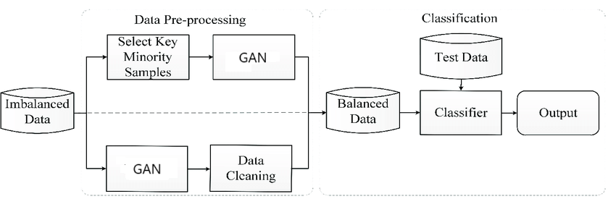
BLOCK DIAGRAM OR FLOW DIAGRAM

Slide 14
METHODOLOGY
Data Preprocessing
Excluded network identifiers (e.g., source/destination IPs, flow ID) to avoid overfitting.
Handling Missing Values:
Numeric columns: Mean imputation.
Non-numeric columns: Most frequent value imputation.
Standardization: Normalized numerical columns using StandardScaler
Encoding: Categorical variables were transformed using OneHotEncoder

Slide 15
Analyzed class distribution showing significant imbalance:
Overrepresentation: DDoS, DoS, and Probe attacks.
Underrepresentation: Rare attacks like User-to-Root (U2R), BOTNET.
Methods for Handling Class Imbalance
Synthetic Data Generation:
GAN (Generative Adversarial Networks):
Generator and discriminator architecture for creating realistic synthetic samples.
Improved minority class representation.
Techniques used: WGAN and CGAN.
SMOTE (Synthetic Minority Oversampling Technique):
Generated synthetic data for underrepresented classes.

Slide 16
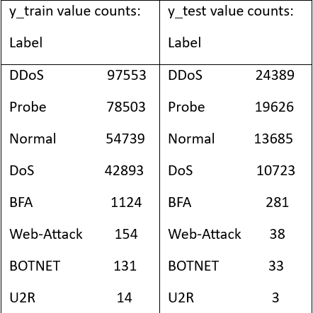

Slide 17
Algorithms and Frameworks
Deep Learning Models:
MLP (Multilayer Perceptron):
Architectures: 6 layers (sizes: 128, 64, 52, 32, 16, 8) and 10 layers (sizes: 512, 256, 1024, etc.).
CNN (Convolutional Neural Networks):
Kernel size: 3; Activation function: ReLU.
SNN (Siamese Neural Networks):
Pairwise similarity-based detection.
Robust against unknown attacks.
Autoencoders:
Detected anomalies via reconstruction errors.
Machine Learning Models:
XGBoost: Gradient boosting for handling complex, high-dimensional data.
Weighted Random Forest (WRF): Assigned higher weights to minority classes.

Slide 18
IMPLEMENTATION
The implementation of the project involved processing the InSDN dataset with 343,889 network flows, addressing class imbalance using techniques like GAN and SMOTE for minority class enhancement. Preprocessing steps included removing irrelevant identifiers, imputing missing values, standardizing numeric data, and encoding categorical variables. Advanced models such as MLP, CNN, and SNN were deployed alongside machine learning models like XGBoost and Weighted Random Forest, achieving high accuracy (up to 99.99% with WRF). Performance was evaluated using metrics like Precision, Recall, and F1-score, demonstrating the effectiveness of GAN-based augmentation and deep learning architectures in improving intrusion detection.

Slide 19
RESULTS & ANALYSIS
The Weighted Random Forest (WRF) model achieved the best results, with an accuracy of 99.99%, demonstrating superior performance in handling class imbalance and detecting intrusions effectively.
The MLP (Multilayer Perceptron) model demonstrated excellent performance, achieving an accuracy of 99.95%. Its deep architecture and ability to learn hierarchical patterns make it particularly effective for larger datasets, enabling it to process complex relationships and deliver high accuracy in intrusion detection.

Slide 20
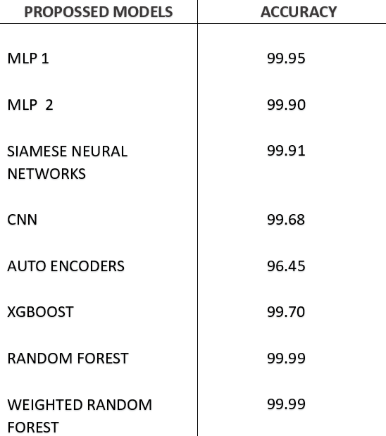

Slide 21
CONCLUSION and FUTURE SCOPE
The minority classes represent very rare but very significant attacks. Such classes detection forms the backbone of SDN intrusion detection. WRF excelled in its task and achieved 99.99% accuracy. SNN and MLP achieved 99.91% and 99.95%, respectively. CNN depicted one strength, that is, an accuracy of 99.68%. To that effect, intrusion detection improved after employing autoencoders but performed poorly when the minority class was considered at 96.45%. Using generative adversarial networks, synthetic data can be generated to balance class representation or improve detection of rare attacks without causing overfitting. Classifier-level methods such as WRF and XGBoost weight the minority classes very well, but this has a limiting effect on larger datasets. Deep learning models, including CNN, MLP, and SNN work very well with com plex data; the CNN model, in this context, had 99.68% accuracy. Future work would thus incorporate enhanced techniques such as ensemble learning, hybrid models, and transfer learning together with real-time analytics and adaptive algorithms to support improvement toward achieving more accuracy and for evolving threats.

Slide 22
REFERENCES
Hassan, H. A., Hemdan, E. E. D., El-Shafai, W., Shokair, M., Abd El-Samie, F. E. (2024). Detection of attacks on software defined networks using machine learning techniques and imbalanced data handling methods. Security and Privacy, 7(2), e350.
Yueai, Z., Junjie, C. (2009, April). Application of unbalanced data approach to network intrusion detection. In 2009 First International Workshop on Database Technology and Applications (pp. 140-143). IEEE.
Alam, T., Ahmed, C. F., Zahin, S. A., Khan, M. A. H., Islam, M. T. (2019). An effective recursive technique for multi-class classification and regression for imbalanced data. IEEE Access, 7, 127615-127630.
Leevy, J. L., Khoshgoftaar, T. M., Peterson, J. M. (2021, August). Mitigating class imbalance for iot network intrusion detection: a survey. In 2021 IEEE Sev enth International Conference on Big Data Computing Service and Applications (BigDataService) (pp. 143-148). IEEE.
Berbiche, N., El Alami, J. (2024). For Robust DDoS Attack Detection by IDS: Smart Feature Selection and Data Imbalance Management Strategies. Ingénierie des Systèmes d’Information, 29(4).

Slide 23
HACILAR, H., Aydin, Z. A. F. E. R., GÜNGÖR, V. Ç. (2024). Network intrusion detection based on machine learning strategies: performance comparisons on im balanced wired, wireless, and software-defined networking (SDN) network traffics. Turkish Journal of Electrical Engineering and Computer Sciences, 32(4), 623-640.
Zhang, G., Wang, X., Li, R., Song, Y., He, J., Lai, J. (2020). Network intrusion detection based on conditional Wasserstein generative adversarial network and cost-sensitive stacked autoencoder. IEEE access, 8, 190431-190447.
Rao, Y. N., Suresh Babu, K. (2023). An imbalanced generative adversarial network-based approach for network intrusion detection in an imbalanced dataset. Sensors, 23(1), 550
Babu, K. S., Rao, Y. N. (2023). A study on imbalanced data classification for various applications. Revue d’Intelligence Artificielle, 37(2), 517.
Babu, K. S., Rao, Y. N. (2023). MCGAN: modified conditional generative ad versarial network (MCGAN) for class imbalance problems in network intrusion detection system. Applied Sciences, 13(4), 2576.

Slide 24
Rezvani, S., Wang, X. (2023). A broad review on class imbalance learning tech niques. Applied Soft Computing, 143, 110415.
Bedi, P., Gupta, N., Jindal, V. (2020). Siam-IDS: Handling class imbalance prob lem in intrusion detection systems using siamese neural network. Procedia Com puter Science, 171, 780-789.
Vu, L., Nguyen, Q. U. (2020). Handling imbalanced data in intrusion detection sys tems using generative adversarial networks. Journal of Research and Development on Information and Communication Technology, 2020(1), 1-13.
Chimphlee, S., Chimphlee, W. (2023). Machine learning to improve the perfor mance of anomaly-based network intrusion detection in big data. Indonesian Jour nal of Electrical Engineering and Computer Science, 30(2), 1106-1119.
Gonzalez-Cuautle, D., Hernandez-Suarez, A., Sanchez-Perez, G., Toscano-Medina, L. K., Portillo-Portillo, J., Olivares-Mercado, J., ... Sandoval-Orozco, A. L. (2020). Synthetic minority oversampling technique for optimizing classification tasks in botnet and intrusion-detection-system datasets. Applied Sciences, 10(3), 794.
Greeshma, B., Sireesha, M., Thirumala Rao, S. N. (2022, February). Detection of arrhythmia using convolutional neural networks. In Proceedings of Second In ternational Conference on Sustainable Expert Systems: ICSES 2021 (pp. 21-30). Singapore: Springer Nature Singapore.

Slide 25

QUESTIONS and ANSWERS

Slide 26

ACKNOWLEGEMENTS

